Slide 1

PITCH DECK PIT-MASTER COMPETITION FUNDRAISER

Slide 2

Bronzemen Foundation Corps
Pitmaster BBQ Competition & Country Dance Festival

Slide 3
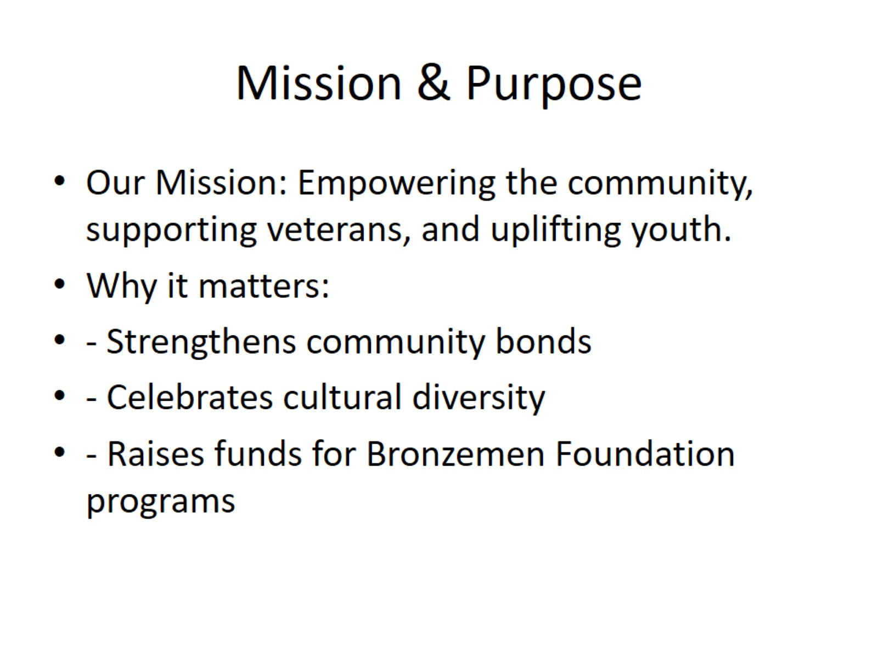
Mission & Purpose

Slide 4
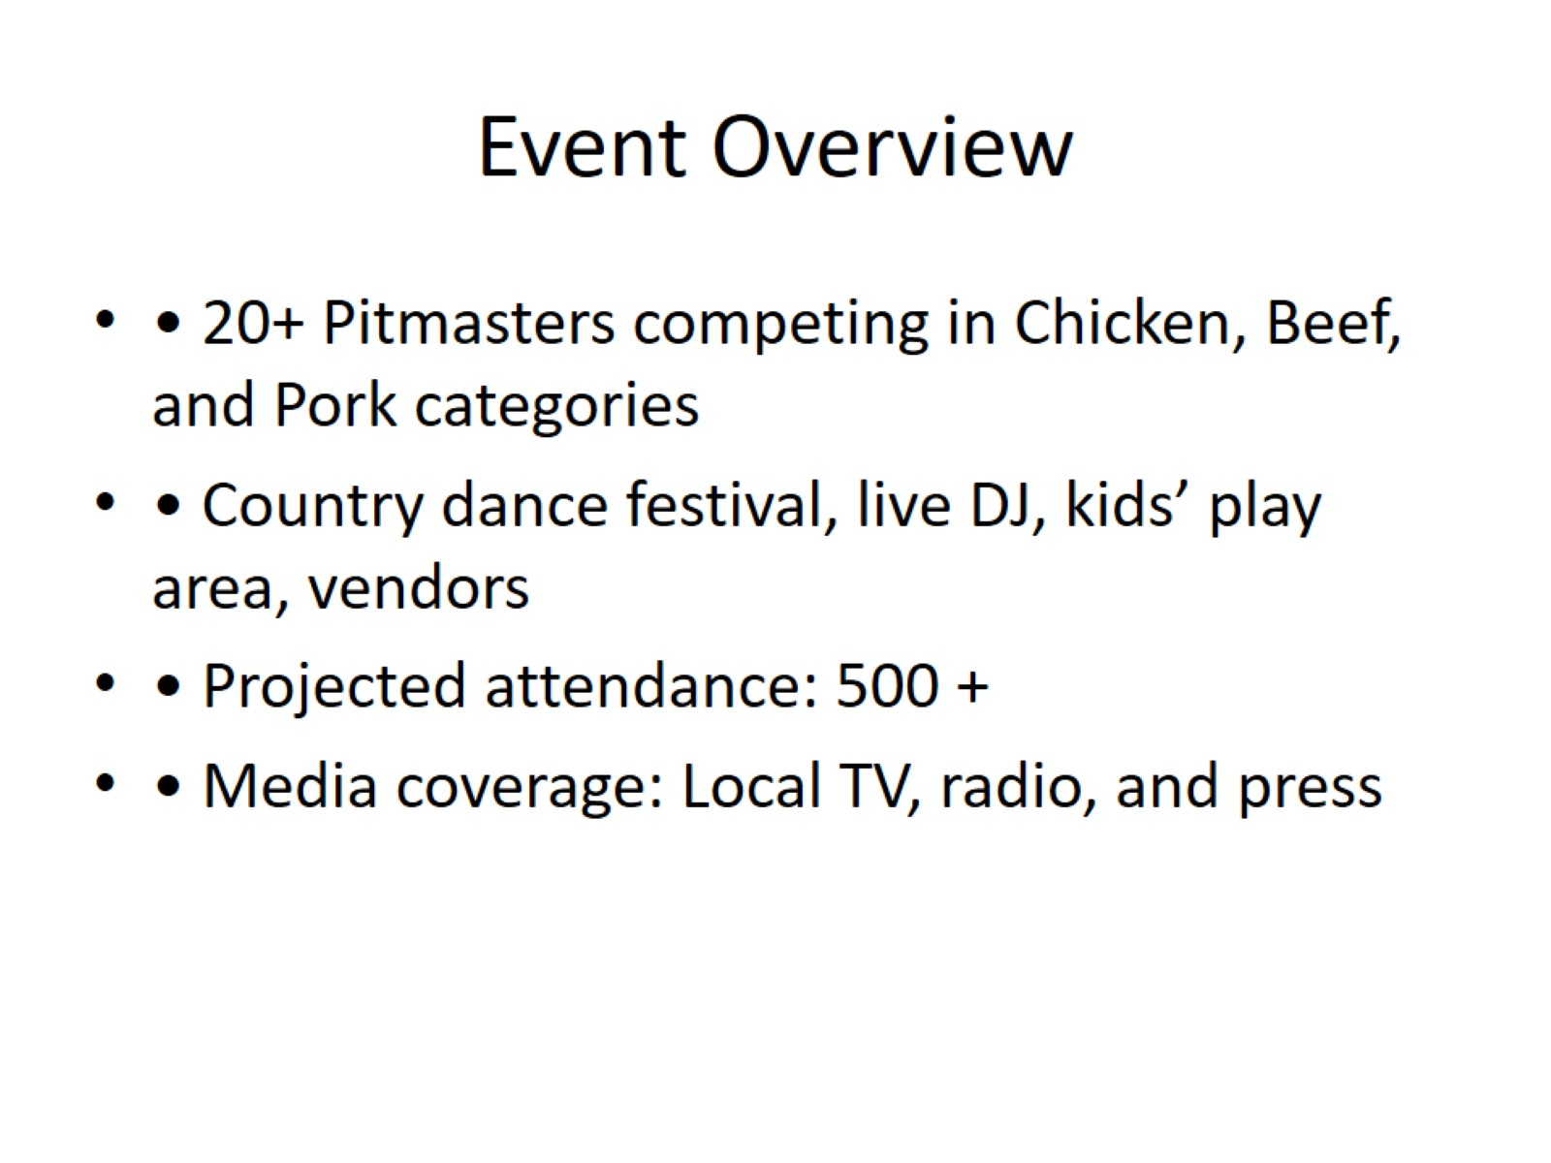
Event Overview

Slide 5
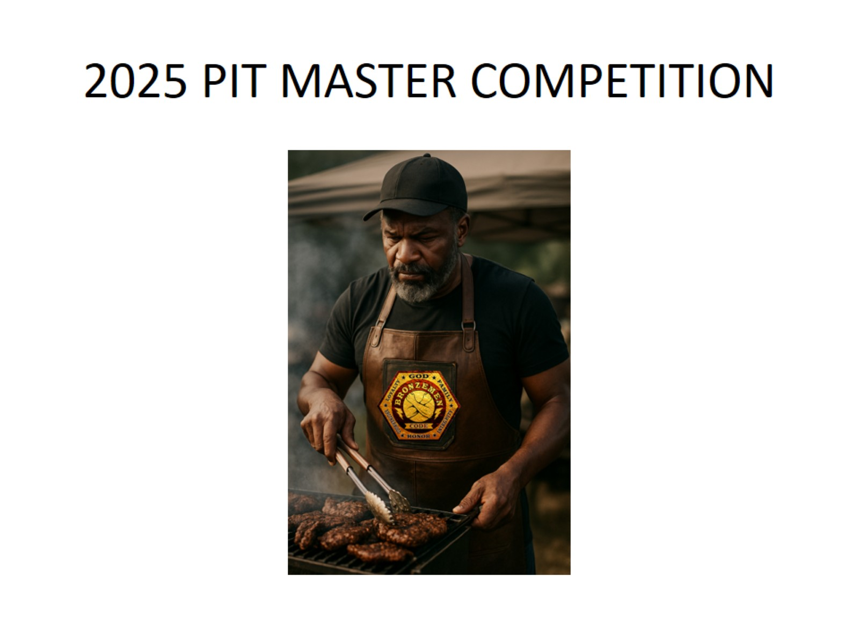
2025 PIT MASTER COMPETITION

Slide 6
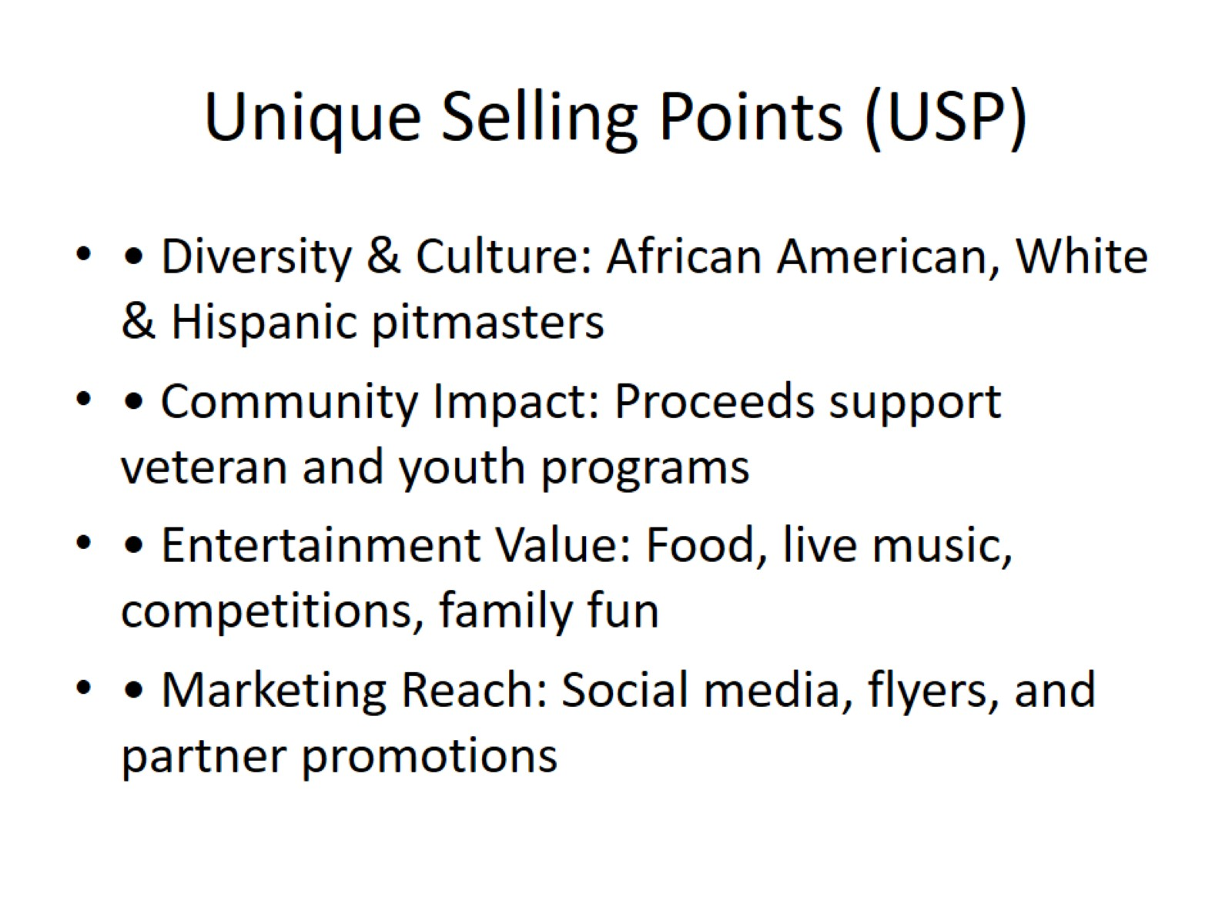
Unique Selling Points (USP)

Slide 7
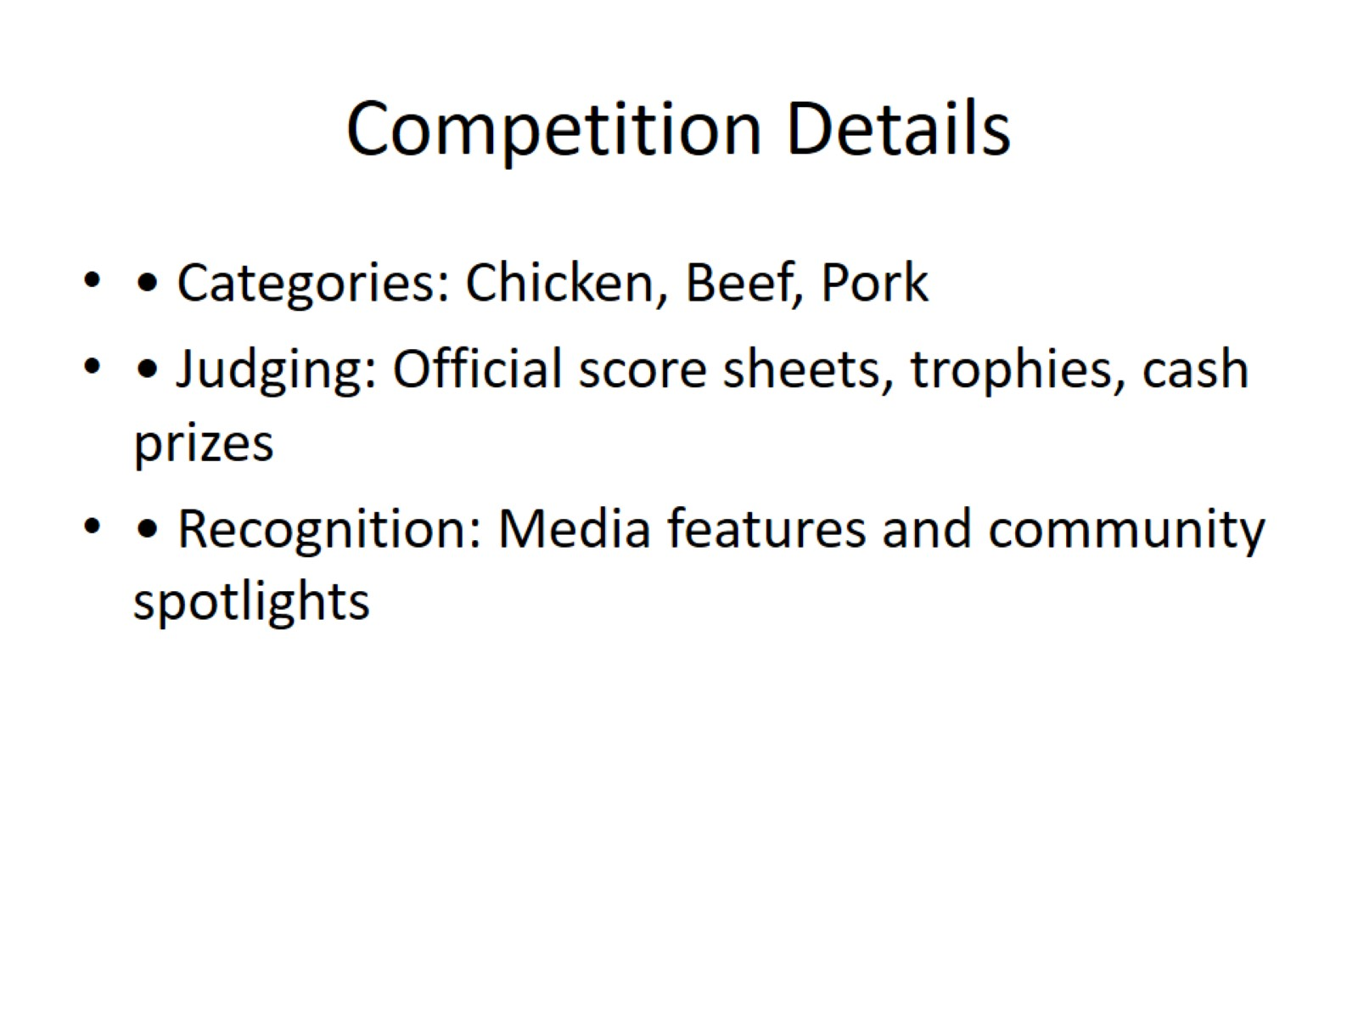
Competition Details

Slide 8
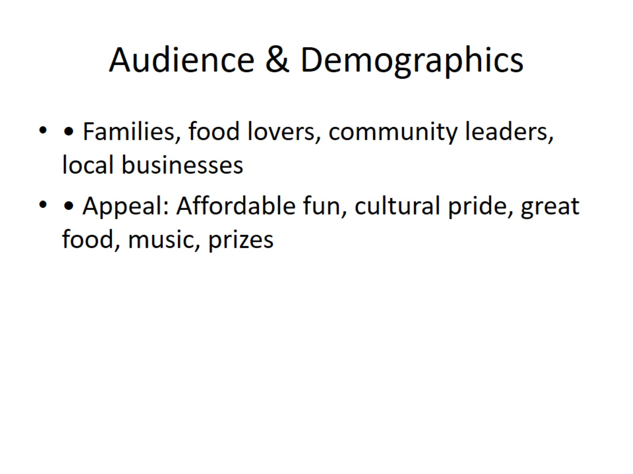
Audience & Demographics

Slide 9
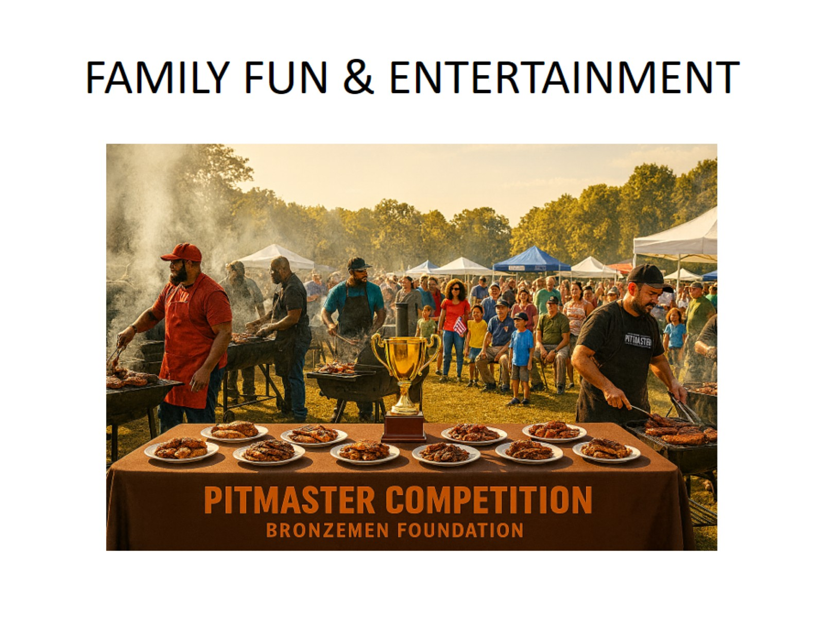
FAMILY FUN & ENTERTAINMENT

Slide 10
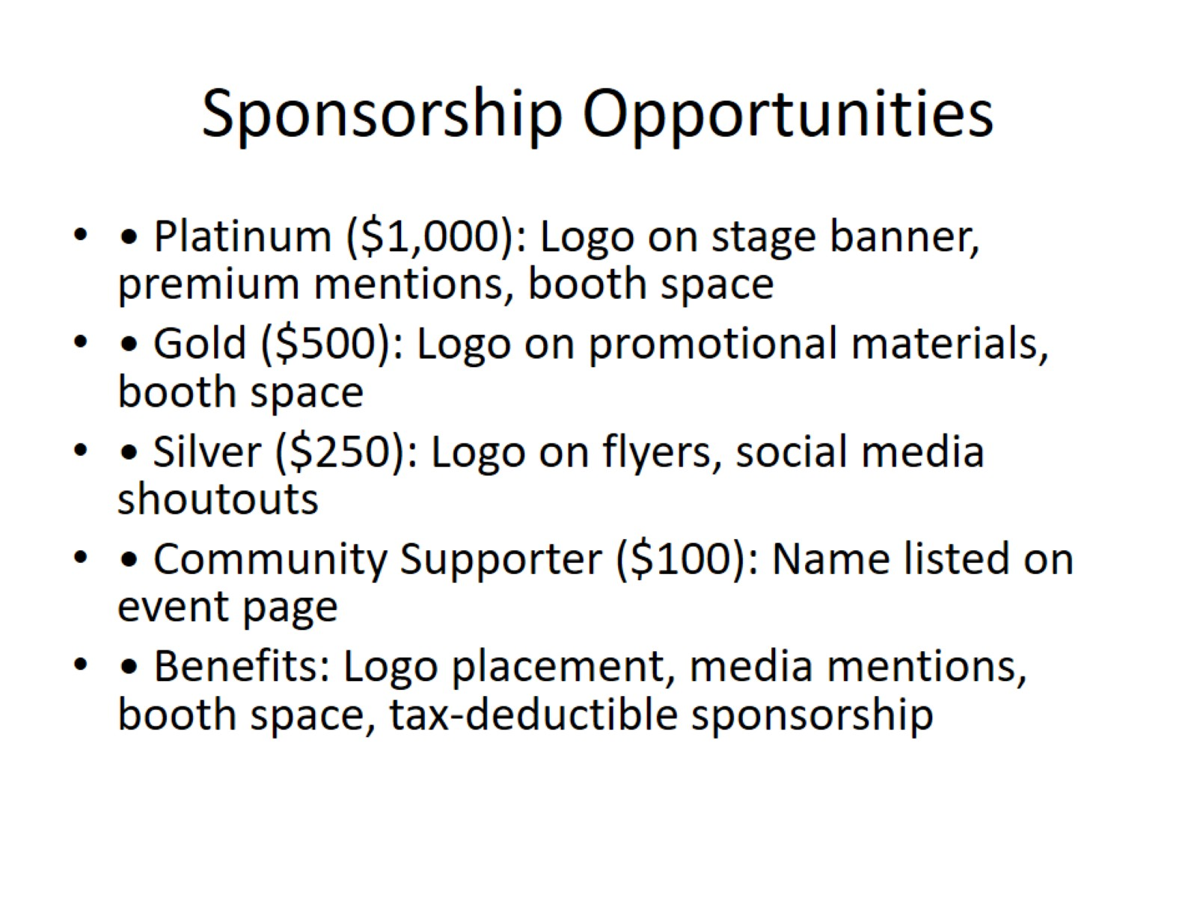
Sponsorship Opportunities

Slide 11
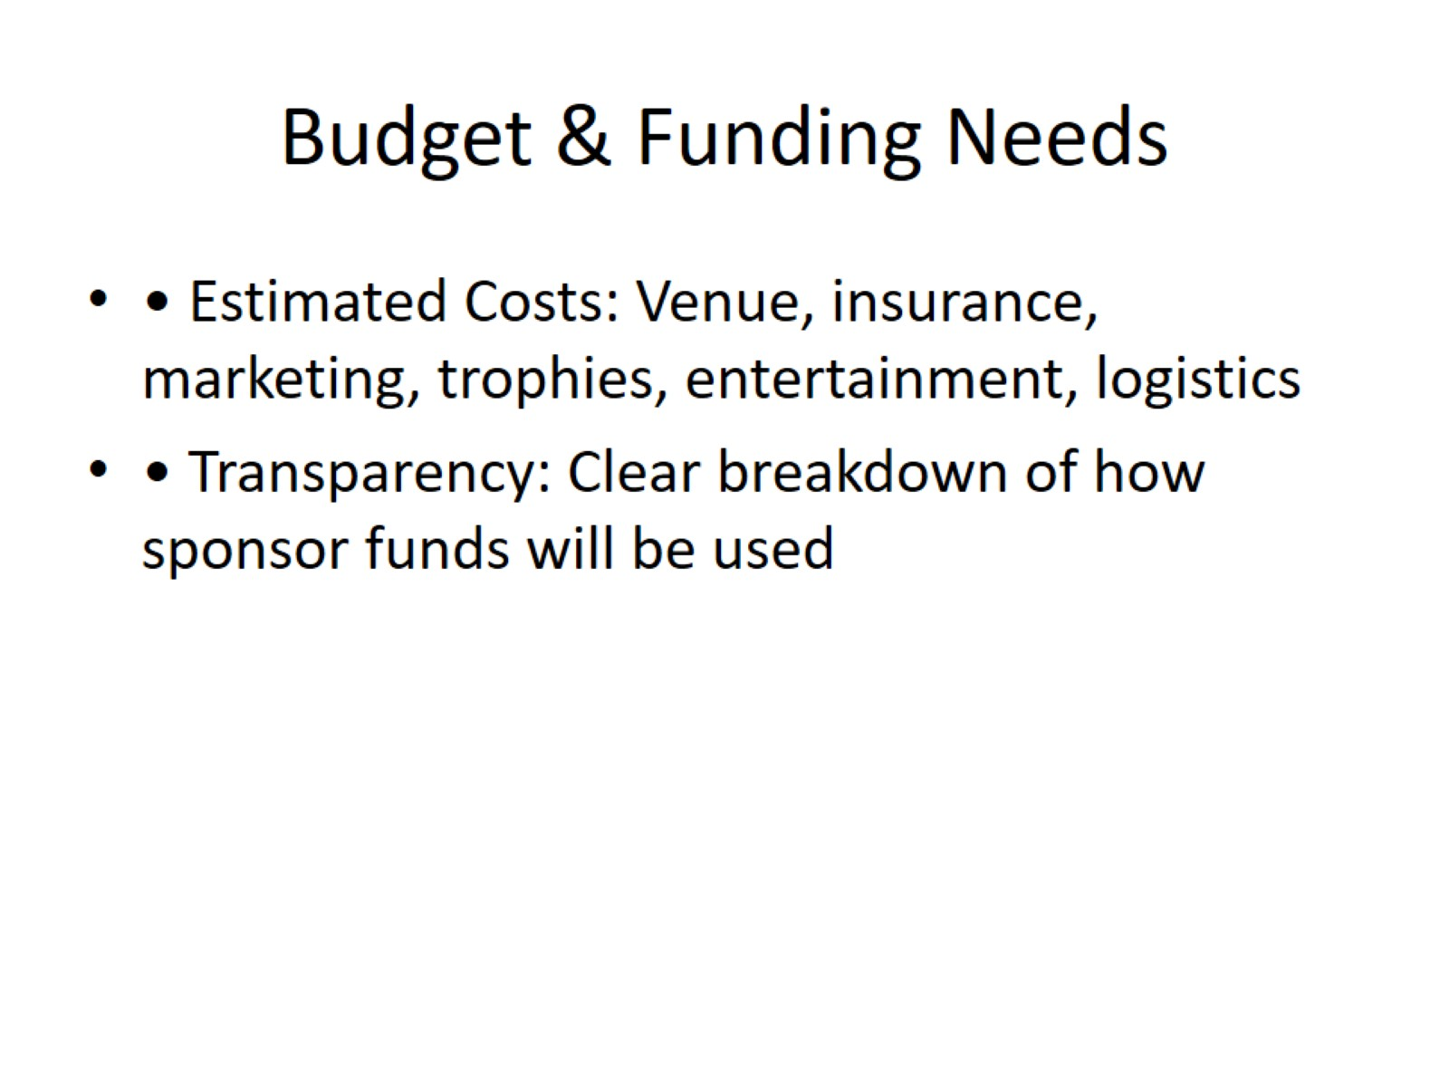
Budget & Funding Needs

Slide 12
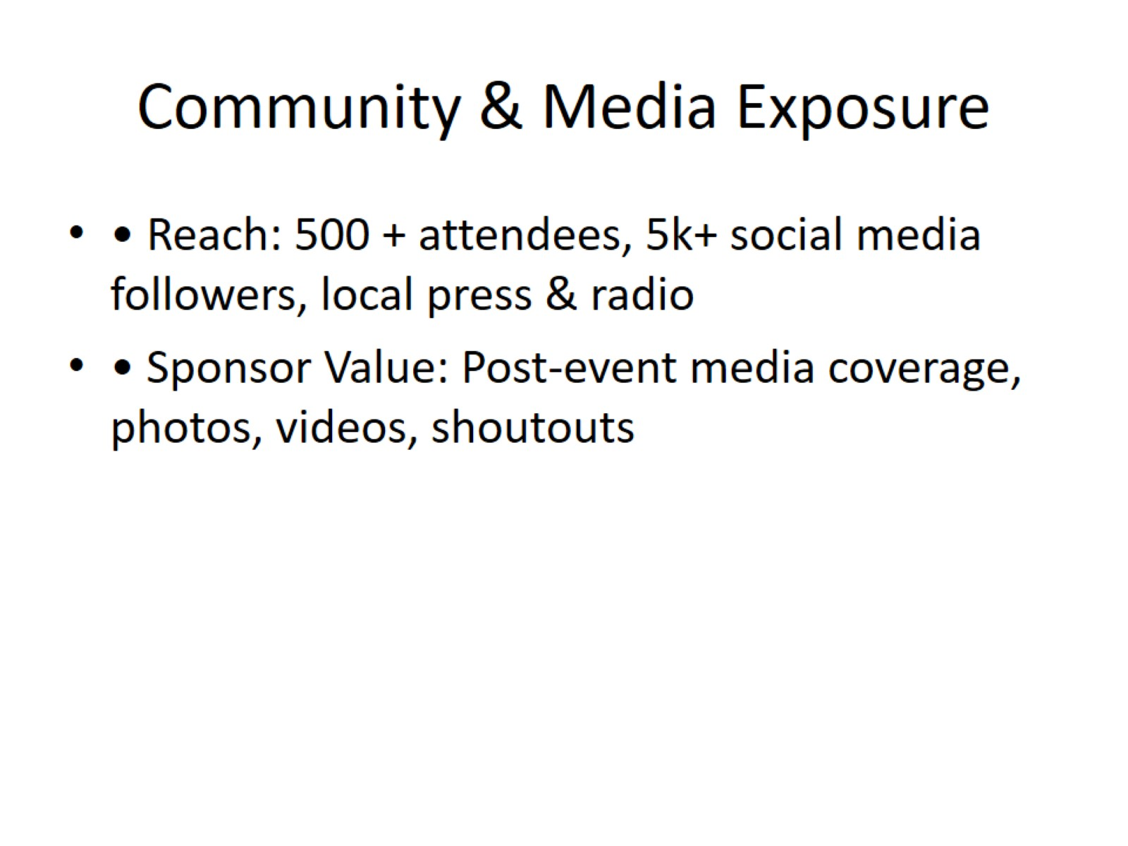
Community & Media Exposure

Slide 13

BECOME A SPONSOR TODAY

Slide 14
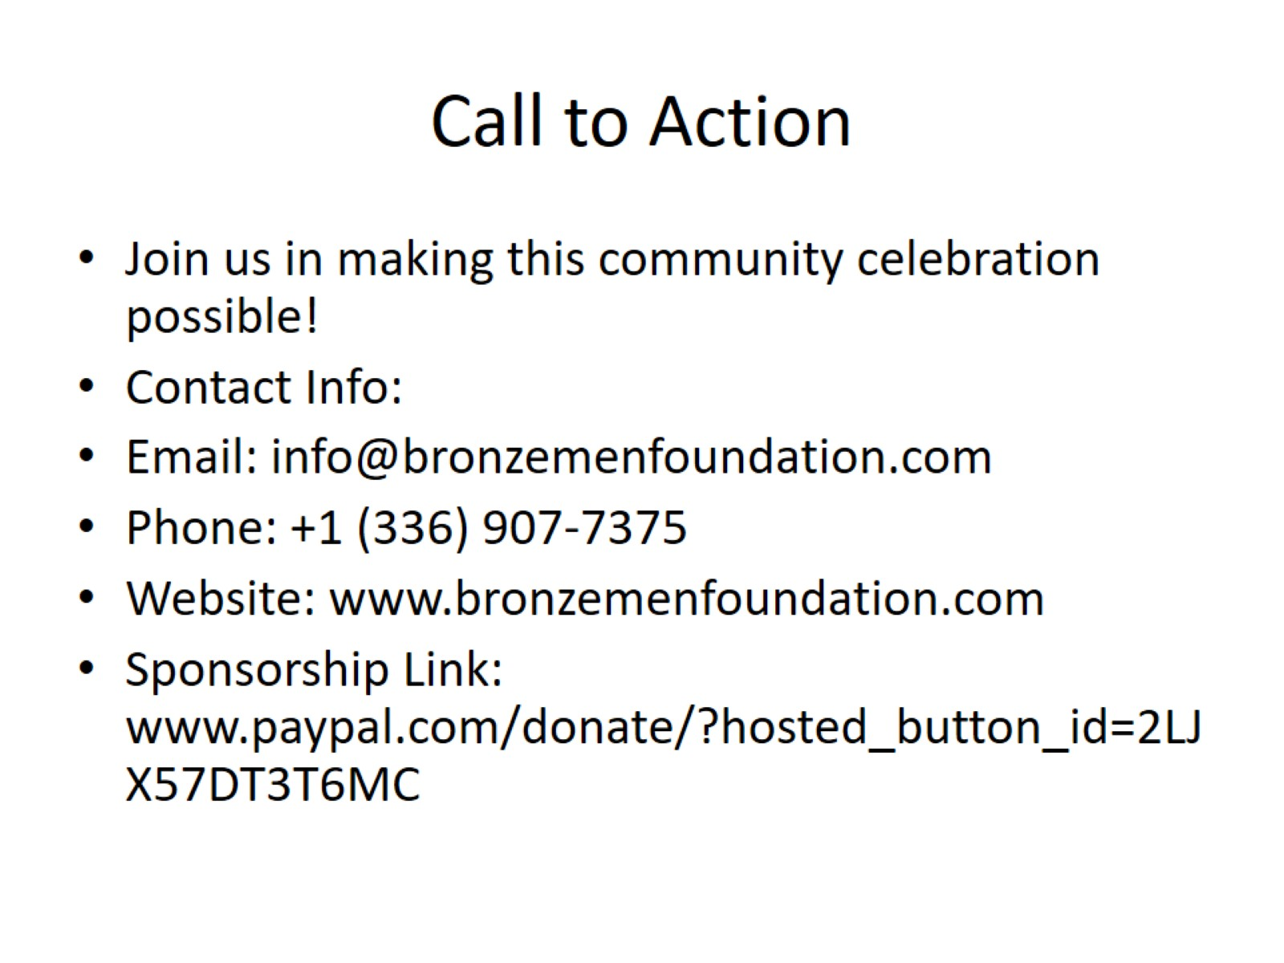
Call to Action

